Slide 1
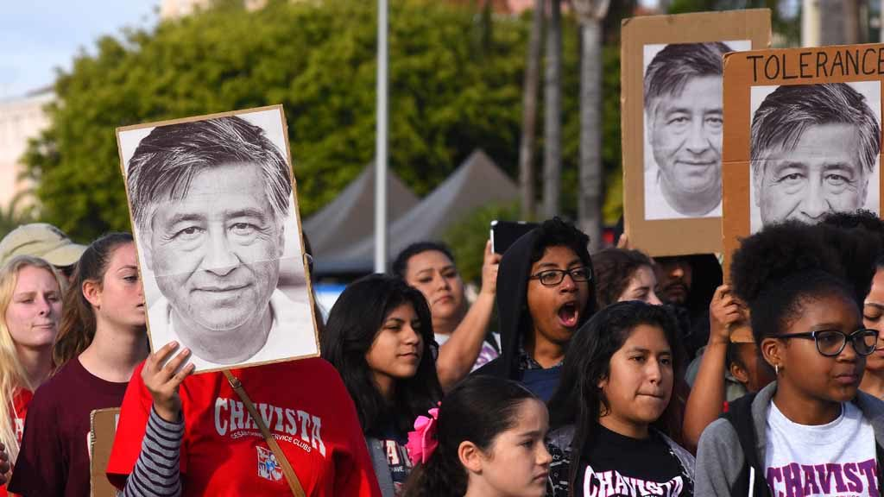
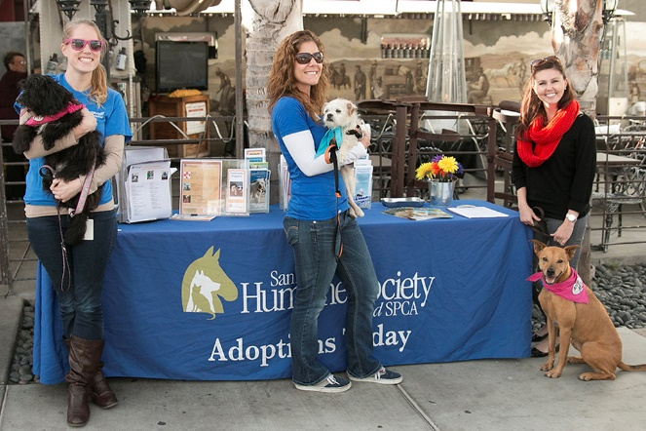
Fiscal Year 2024
Community Projects, Programs, and Services (CPPS) Funding
Notes:
Malachi Bielecki:
Good evening, my name is Malachi Bielecki and I’m a Grants Coordinator with Council Administration here at the City of San Diego. My colleague Abigail Edwards and I are here to present the Community Projects, Programs, and Services funding program for Fiscal Year 2024, and we are also here to answer any of your questions. I would like to ask that you please hold your questions until the end of the presentation.

Slide 2
Partnering with the City Council Offices: CPPS Funding
Community Projects, Programs and Services (CPPS) Funding Program
Background
CPPS funding is awarded to nonprofit organizations and public agencies for projects, programs, or services that serve a lawful public purpose in order to benefit the City’s neighborhoods and communities.
CPPS funding is awarded at the discretion of each Council Office.
CPPS is governed by Council Policy 100-06, which is currently undergoing changes.
Notes:
CPPS funding is awarded to nonprofit organizations and public agencies for projects, programs, or services that serve a lawful public purpose in order to benefit the City’s neighborhoods and communities.
CPPS funding is awarded solely at the discretion of each individual Council Office and the rules governing the program are articulated in Council Policy 100-06. It is worth noting that the Council policy has been undergoing significant changes. We are expecting Council to approve the new policy in the coming weeks. As such, the information in this presentation includes the expected changes.

Slide 3
Partnering with the City Council Offices: CPPS Funding
FY24 CPPS Council Office Funding
Funding Summary
FY24 CPPS Total Funds: TBD
$1,683,767 in FY23
CPPS Funds:
Contracts
Non-Profits or Public Agencies
Transfer Memorandum:
City Departments
City Capital Improvement Projects (CIP)
Notes:
The total funding for fy24 is still to be determined, we will have a better idea of the final number once the Budget Revise is released in the coming weeks. However Last fy the budget of just over $1.6 million
Council Offices may use their CPPS funding in a handful of different ways. Primarily, they can award funds to non-profit organizations or public agencies, Less commonly, Council Offices can also transfer CPPS funds to other City departments to pay for things like streetlights, or they may allocate funding to an existing City capital improvement project.

Slide 4
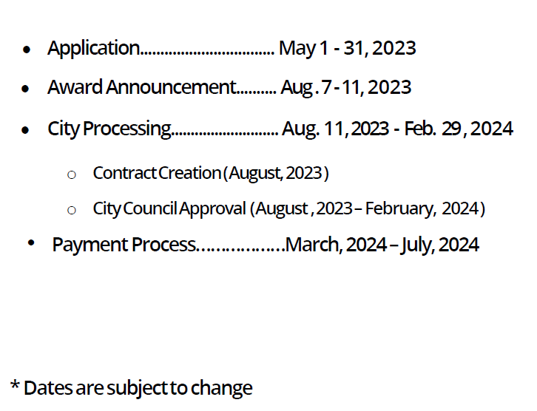
Partnering with the City Council Offices: CPPS Funding
CPPS Schedule
Fiscal Year 2024 Schedule
Notes:
Above you can see the schedule for Fiscal Year 2024. The application process is from May 1-31st. There will be a brief cure period in early June where we will work with any applicants that have issues with their paperwork or legality. Once confirmed for eligibility, the Council Offices will select their award allocations, which will be announced publicly in early August. The next six months will be spent bringing the funding Agreements to the full City Council for approval in order to process payments as early as March. Compared to the fiscal year 2023, the schedule has been moved up in order to better align with the City’s fiscal year and to provide more time between the processing of payments and the end of the fiscal year.
We anticipate a high volume of applicants, so please submit paperwork as soon as possible in order to ensure timely responses to any questions.

Slide 5
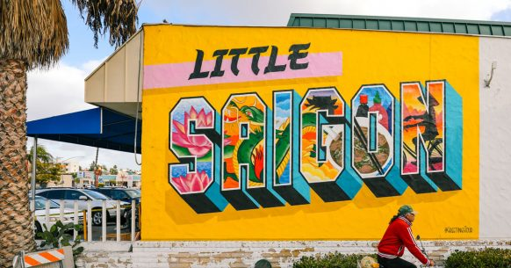
Partnering with the City Council Offices: CPPS Funding
CPPS Council Policy
Funding Eligibility
Hold a legally tax exempt or not for profit status in good standing or be a public agency functioning within the City.
Not be on any State or Federal debarment list.
Hold an “ACTIVE” status with the California Secretary of State.
Hold a “CURRENT” status with the California Attorney General.
Be able to prove financial solvency by providing documentation such as an IRS Form 990.
Be able to disclose all sources of organization funding.
Notes:
Organizations must hold a legally tax exempt or nonprofit status,hold an “ACTIVE” status with the California Secretary of State, hold a “CURRENT” status with the California Attorney General, be able to provide a recent IRS Form 990, and be able to disclose all sources of your organization’s funding. It is worth noting that an organization will need to have good standing with these entities at the time of application submission and throughout the entire fiscal year. The City cannot enter into Agreements with organizations who do not hold good standing with the AG and SOS.
In the case that an organization does not meet these requirements, they can apply using a fiscal sponsor

Slide 6
Partnering with the City Council Offices: CPPS Funding
CPPS Council Policy
Funding Uses
1. Capital improvements performed on private property.
Facilities must be open to the public (cannot require membership).
Projects with a total cost over $15,000 that involve alteration, demolition, installation or repair work will be subject to prevailing wage law.
Projects with a total cost over $25,000 that involve new construction work will be subject to prevailing wage law.
Projects may not be performed on public property, even with a right-of-entry permit.
Notes:
An organization may request CPPS funds to perform cip on private property so long as the space undergoing work will be open to the public and not require an organizational membership for access. Additionally, please be aware that certain projects may trigger prevailing wage law if their costs are above a certain threshold. For work involving alteration, demolition, installation or repairs, that threshold is $15,000. For new construction, that threshold is $25,000. Please note that these numbers refer to the total cost of the project, not just the amount of CPPS funds contributing to the project. Lastly, projects cannot be performed on public property, even if an organization has a right-of-entry permit. Projects on public property are considered public works, which CPPS cannot accommodate. An example of an eligible CIP would be a request for funding to renovate a community room or another part of a facility that is open to the public.

Slide 7
Partnering with the City Council Offices: CPPS Funding
CPPS Council Policy
Funding Uses
2. The purchase of equipment, materials, goods, supplies, technology, or educational services.
Unless they are a component of a larger public works project.
Cannot purchase surveillance technology.
3. The staging of social, environmental, educational, cultural, or recreational community programming or events.
Ticketed events are allowable if they are open to the public and do not require organizational memberships.
Travel expenses are no longer prohibited but may be subject to greater scrutiny.
Notes:
An organization may request CPPS funds to purchase equipment, materials, goods, supplies, technology, or educational services examples would include purchasing a van for a homeless assistance team, purchaseing software, or purchasing uniforms for an organization. please note you cannot purchase surveillance technology, such as security cameras You can also you funds to stage social, environmental, educational, cultural, or recreational community programming or events.Ticketed events are allowable so long as they are open to the public and do not require organizational memberships, but these events may be subject to greater scrutiny during review. Some examples of eligible funding requests of this type would be payments for the rental of a venue to stage a play or the payment of stipends to performing artists. Travel expenses, such as expenses for field trips, are also no longer prohibited,

Slide 8
Partnering with the City Council Offices: CPPS Funding
CPPS Council Policy
Funding Uses
4. The purchase of food or beverages only if they are provided to individuals or families in need.
Cannot be purchased for other uses.
5. The payment of ongoing operational expenses.
Including payroll expenses, rent payments, utility payments, and insurance payments.
These requests may be subject to greater scrutiny during review.
Notes:
Organizations may request CPPS funds to purchase food or beverages, but only if they are provided to individuals or families in need. An example of an eligible request of this type would be if a foodbank or homeless shelter used CPPS funding to purchase food for needy families.
And lastly, organizations may request CPPS funds to pay for ongoing operational expenses, including but not limited to payroll expenses, rent payments, utility payments, and insurance payments, though these requests may be subject to greater scrutiny during review. An example of an eligible request of this type would be using funds to make rent payments on an office or facility.

Slide 9
Partnering with the City Council Offices: CPPS Funding
CPPS Council Policy
Program Reminders
CPPS funds cannot be used for any purpose prohibited by laws governing the use of public funds.
No private, political, religious, or fundraising purpose or activity.
Fundraising galas are not a permissible use of funds.
Council Offices may prioritize funding requests for “one-time”
Council Offices may encourage applicants to pursue matching funds.
Project/program/service must occur within AND funds must be spent within Fiscal Year 2024 (July 1, 2023 – June 30, 2024).
Notes:
Malachi Bielecki:
Here’s some other important program reminders:
CPPS funds cannot be used for private, political, religious, or fundraising purposes or activities. An example of a common event with which the use of CPPS funds would be not be permissible is the hosting or attending a fundraising gala.
Council Offices may prioritize funding requests for “one-time” uses, meaning that there may be greater scrutiny toward funding requests for ongoing operational expenses that will require continuous funding to sustain.
Council Offices may encourage applicants to pursue matching funds and may give preference to those who have matching funds available for their project.
Lastly, any project, program, or service must occur within, and funds must be spent within Fiscal Year 2024, which is between July 1, 2023, and June 30, 2024.

Slide 10
Partnering with the City Council Offices: CPPS Funding
CPPS Projects/Programs/Events
Examples from FY23
Meals on Wheels: Senior Meal Deliveries
San Diego Second Change Program: Job Readiness Training
Old Town San Diego Chamber of Commerce: New Visitors Center
People Assisting the Homeless (PATH): Van for Interim Housing Program
Rolando Community Council: Rolando Street Fair
Notes:
Malachi Bielecki:
Here are some examples of organizations and projects that received CPPS funding in Fiscal Year 2023:
Meals on Wheels was awarded funding for their senior meal delivery program.
San Diego Second Chance Program was awarded funding for their job training program.
Old Town San Diego Chamber of Commerce was awarded funding to help construct a brand-new visitors center.
Pacific Arts Movement was awarded funding to assist in their operational capacity.
People Assisting the Homeless, or PATH, was awarded funding to purchase a van for their housing assistance program.
And Rolando Community Council was awarded funding to host a street fair.
These are just a few of over 200 diverse projects that received funding in Fiscal Year 2023.

Slide 11
Partnering with the City Council Offices: CPPS Funding
CPPS Application
Pre-Application
We recommend contacting the Council Office(s) that the organization will be requesting funding from to learn more about their funding priorities.
Ensure that the organization can meet all standards required by Council Policy 100-06.
The organization must be in good standing no later than the time of application submittal.
Recognize that applying for CPPS funding does not guarantee that an organization will receive funding.
Notes:
Malachi Bielecki:
Here are a few steps an organization should take prior to applying.
We recommend that organizations contact the Council Offices that they would like to request funding from. Since CPPS funding is awarded strictly at the discretion of each office, it is in an organization’s best interest to communicate with the council offices
Next, ensure that your organization can meet all Council Policy requirements. Organizations must be able to meet these standards by the time of application submittal.
Lastly, recognize that applying for CPPS funds does not guarantee that an organization will receive funding.

Slide 12
Partnering with the City Council Offices: CPPS Funding
CPPS Application
Application Overview
Use the CPPS Application Instructions as a guide.
An organization may submit multiple applications.
Only one project/program/service allowed per application.
May apply for funding from multiple Council Offices within the same application.
A funding request may not be for less than $1,500.
Demonstrate that the project/program/service is open to the public, provides a public purpose, and is of value to San Diego communities.
Notes:
Malachi Bielecki:
Here is an overview of the application process:
We suggest using the detailed application instructions linked in this PowerPoint and on our webpage as a guide. It will likely have the answer to any questions that may arise.
An organization may submit multiple applications, but only one project, program, or service is allowed per application. Within an application, an organization may apply for funding from multiple Council Offices.
Funding requests and awards may not be less than $1,500. In the past, organizations have received awards as small as $1,500 and as large as $35,000.
Lastly, be able to demonstrate that the project, program, or service is open to the public, provides a public purpose, and is of value to San Diego communities and neighborhoods.

Slide 13
Partnering with the City Council Offices: CPPS Funding
CPPS Application
Application Overview
Due at the time of application:
Standard application
Proof of nonprofit status (IRS Determination Letter)
Proof of “ACTIVE” status with the CA SOS
Proof of “CURRENT” status with the CA AG
Certification for a Drug Free Workplace
EOC Workforce Report (pages 1-3)
IRS Form 990, 990EZ, or 990N
IRS Form W-9
Notes:
Malachi Bielecki:
The following is due at the time of application submittal:
A completed standard application, which will be available on the CPPS webpage and provided to our email distribution list.
An IRS determination letter showing proof of nonprofit status.
Confirmation of an ACTIVE status with the California Secretary of State and a CURRENT status with the California Attorney General.
A completed Drug Free Workplace report.
A completed EOC Workforce Report.
An IRS Form 990, 990EZ, or 990N.
And lastly, an IRS Form W-9.
It is very important that your organization fills in all fields on these forms where possible, paying special attention to signatures and dates. Any missing information may result in a delay for your application or loss of eligibility.

Slide 14
Partnering with the City Council Offices: CPPS Funding
CPPS Application
Supplemental Documentation
To check an organization’s nonprofit status:
Use the Tax Exempt Organization Search tool to find information on an organizations’ status.
Organization not on website or lost letter:
Contact Customer Account Services by phone, letter, or fax to request an affirmation letter.
A letter or fax requesting an affirmation letter must include your organization’s:
Full name
Employer Identification Number
Authorized signature (an officer or trustee)
Notes:
Malachi Bielecki:
To check your organization’s nonprofit status, you can use the IRS online tool known as the Tax-Exempt Organization Search. In the case that you cannot locate your organization’s status when you believe the IRS should have it on file, you will need to contact their customer service.

Slide 15
Partnering with the City Council Offices: CPPS Funding
CPPS Application
Supplemental Documentation
ACTIVE status from the CA SOS
Status must remain ACTIVE for the duration of the fiscal year.
CURRENT status from the CA AG
Status must remain CURRENT for the duration of the fiscal year.
Notes:
Malachi Bielecki:
Both the California Secretary of State and California Attorney General have online portals which an organization can easily access to check their status. It is important to note that the statuses must remain active and current for the duration of the fiscal year. Otherwise, the City may not be able to process CPPS payments. Please pay careful attention to any outstanding documentation or fees owed to these entities as well as registration and renewal dates. Note that both can take up to 90 days to process paperwork, so it is important to remain aware of impending deadlines.
When providing us with proof of these statuses, a screenshot of an organization’s status on the respective web portals is sufficient.

Slide 16
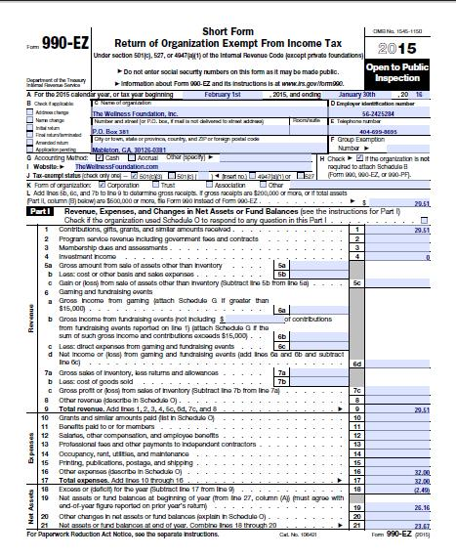
Partnering with the City Council Offices: CPPS Funding
CPPS Application
Additional Forms
Certification for a Drug Free Workplace
The City requires that all City grantees comply with the Drug-Free Workplace Policy (Council Policy 100-17).
EOC Workforce Report
Pages 1-3 must be completed in full.
IRS Form 990
Form 990-EZ, Form 990-PF, and Form 990-N (e-Postcard) accepted.
IRS Form W-9
Notes:
Malachi Bielecki:
The Certification for a Drug Free Workplace is a simple form that the City requires for entering contracts. The EOC Workforce report collects gender and ethnic information on an organization’s workplace, and we will need pages 1-3 filled out as completely as possible. For this form, it is perfectly fine to put “0” or “N/A,” for not applicable, in any categories for which an organization is unable to answer. Both forms will be available to complete directly within the online standard CPPS application.
The IRS Form 990 is the standard form that we use to verify financial solvency, though if a new organization hasn’t yet had received a 990 then we can likely use other financial documentation. Public agencies are not required to provide this form.
And lastly, the IRS Form W-9 is an easy form that just requires some basic information about an organization.
It is very important that organizations fill in ALL required fields, especially for signatures and dates. Any missing information can cause a delay in the application or a loss of funding eligibility.

Slide 17
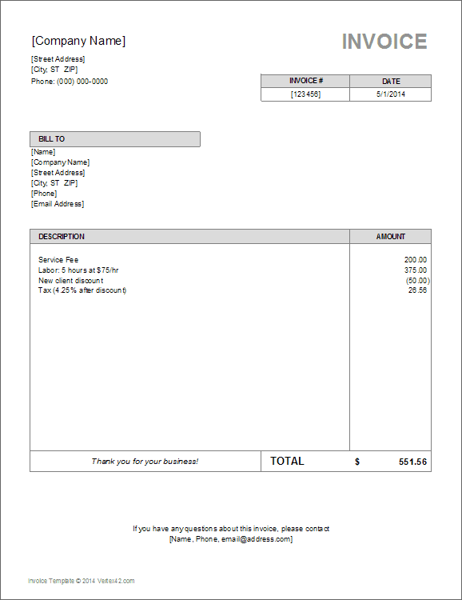
Partnering with the City Council Offices: CPPS Funding
CPPS Payments
Payment and Funding Procedure
All funding Agreements must be approved by the full City Council before payments are dispersed.
This process is projected for completion by April 2024.
Once an Agreement is approved, an organization may be reimbursed for expenses already incurred or granted upfront for expenses not yet incurred.
Only expenses delineated in the “Use of City Funds” section of the application as enclosed in the signed Agreement are permissible uses of awarded funds.
Notes:
Malachi Bielecki:
All funding awards allocated by Council Offices must be docketed to appear before the full City Council for approval, which is a process that can take some time. Any funding Agreement between the City and your organization is not technically executed, and payments cannot be sent until this is finalized. For Fiscal Year 2024, we project that this process will be completed around April 2024. Once Council approves an Agreement and all City parties have signed on, an organization will be paid their full award amount. In practical terms, this means that an organization will be effectively reimbursed for any expenses already incurred in the fiscal year and/or granted upfront for expenses not yet incurred.
Only expenses mentioned in the “Use of City Funds” section of an application are permissible uses of awarded funds. If an organization documents expenses that do not meet this criteria, the organization mus either update their documentation with a compliant use of funds, or the City will have the right to pursue a return of the funds.

Slide 18
Partnering with the City Council Offices: CPPS Funding
CPPS Payments
Payment and Funding Procedure
Council Administration will provide a reporting template.
Please retain:
Proof of Purchase documentation (i.e. receipts, invoices, pay stubs, time sheets, etc.).
Proof of Payment documentation (i.e. bank/credit card statement, cancelled check, etc.).
All documentation is due no later than 30 days after the end of Fiscal Year 2024, on July 31, 2024.
Organizations which fail to meet this requirement will be placed on a “Delinquency” list.
Notes:
Malachi Bielecki:
When it is time to submit reporting documentation, Council Administration will contact an organization with instructions. Please take care to maintain records including proof of purchase documentation, which may include receipts, invoices, pay stubs, or time sheets, and proof of payment documentation, which may include bank statements, credit card statements, or cancelled checks.
All documentation is due no later than 30 days after the end of Fiscal Year 2024, by July 31, 2024. Organizations which fail to meet this requirement will be placed on a “Delinquency list” which may preclude the organization from receiving CPPS funding in the future.

Slide 19
Partnering with the City Council Offices: CPPS Funding
CPPS Payments
Payment and Funding Reminders
CPPS funds cannot be dispersed until Agreements are approved by the full City Council and signed by City departments.
Projected for April 2024.
Funds may be utilized for any eligible expenses incurred within the City’s Fiscal Year 2024 (July 1, 2023 – June 30, 2024).
Funding may be provided on a reimbursement basis or upfront depending on the date of purchases.
Full award will be dispersed once the Agreement is approved by the full Council
Receipt of payment from the City can take up to 60-90 days once approved.
Notes:
Malachi Bielecki:
CPPS funding is no longer reimbursement only, but funds cannot be dispersed until funding Agreements are approved by the full City Council and signed by all relevant City departments.
CPPS funding may be utilized for any eligible expense identified in your organization’s funding Agreement that was incurred within the City’s Fiscal Year 2024, which is from July 1, 2023, to June 30, 2024. For example, if your organization requests funding for purchases made in October 2023, the City will not be able to send a payment until the Agreement is executed, likely no sooner than March 2024. However, if your organization requests funding for an event in June 2024, it is possible that CPPS funds could be dispersed for that project upfront. Either way, your organization will be paid the full award amount as soon the Agreement is executed by Council, and all documentation will be due 30 days after the end of the fiscal year.
It is important to note that receiving payment from the City can take up to 60-90 days once a payment is approved. As such, we strongly recommend that CPPS recipients be prepared to finance any proposed programs, projects, or services upfront since payment can be delayed.

