Slide 1
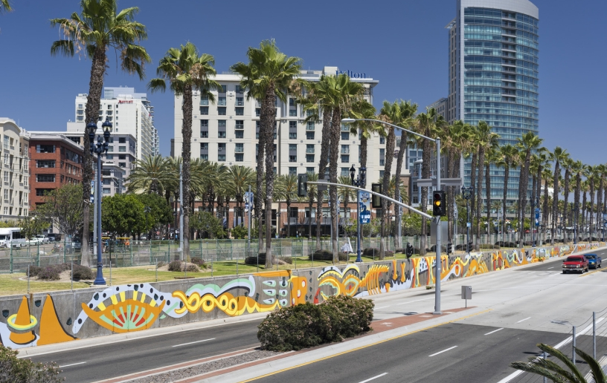
Council Office CPPS & ACCF Funding Fiscal Year 2025
Council Administration
Abigail Edwards, Grants Manager
Malachi Bielecki, Grants Coordinator
Notes:
Hi everyone! Thank you so much for joining us as we provide an overview of the upcoming grant cycles for the CPPS funding, which we are excited to announce is funded in the City’s Fiscal Year 2025 budget. My name is Malachi Bielecki and I’m a Grants Coordinator with Council Administration here at the City of San Diego. Our team manages the grant process on behalf of the City Council Offices and we’ll be your primary points of contact for any related questions.

Slide 2
Partnering with the City Council Offices: CPPS Funding
Community Projects, Programs and Services (CPPS) Funding Program
Background
CPPS funding is awarded to tax exempt or nonprofit organizations and public agencies for projects, programs, or services that serve a lawful public purpose to benefit the City’s neighborhoods and communities.
CPPS funding is awarded at the discretion of each Council Office.
CPPS is governed by Council Policy 100-06, which was revised last year.
Notes:
Community Projects, Programs, and Services, or CPPS, funding is awarded to tax exempt or nonprofit organizations and public agencies for projects, programs, or services that serve a lawful public purpose to benefit the City’s neighborhoods and communities. The most typical designation for a grantee is a 501(c)(3) organization, however, we do accept grantees with other tax-exempt designations such as 501(c)(6) and 501(c)(4).
CPPS funding awards are granted solely at the discretion of each individual Council Office as this grant provides allows them to connect directly with the needs of their communities and the city as a whole. Our department is not involved in funding decisions, but we do vet applicants for eligibility and compliance and administer the application and contract processes.
The rules governing the CPPS program are articulated in Council Policy 100-06, which is available online. We strongly recommend that applicants familiarize themselves with this document as it articulates the program requirements. Lastly, it is worth noting that the Council Policy was recently revised to expand eligibility and move away from reimbursements and instead to upfront grant payments.

Slide 3
Partnering with the City Council Offices: CPPS Funding
FY25 CPPS Budget
Budget Summary
FY25 CPPS Funds: $900,000
$100k per office
CPPS Funds:
Contracts
Nonprofits or Public Agencies
Transfer Memorandum
City Departments
City Capital Improvement Projects (CIP)
Notes:
The City’s recently approved Fiscal Year 2025 budget includes a $900,000 allocation for CPPS. This number is divided across the nine Council Offices, with each office maintaining a CPPS discretionary fund of $100,000 and each of them making their own grant funding decisions. Council Offices may use their CPPS funding in two different ways. Most of the time, funds are awarded as grants to nonprofit organizations or public agencies to carry out community projects, programs, or services compliant with the council policy. This past fiscal year, over 90% of the CPPS budget was used for these purposes. Less often, Council Offices transfer CPPS funds to City departments for similar uses compliant with the council policy or they may allocate funding to an existing City capital improvement project, or CIP.

Slide 4
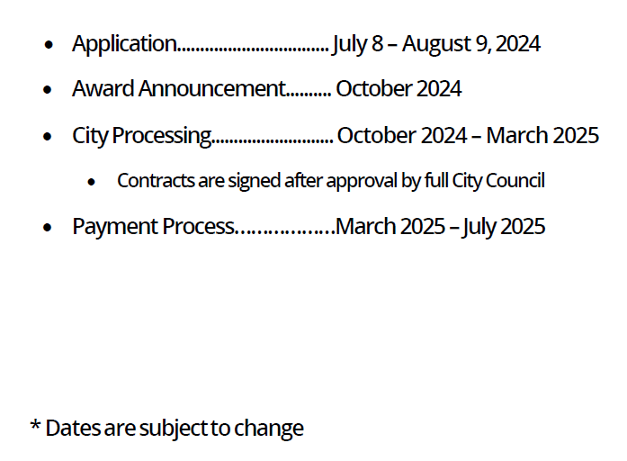
Partnering with the City Council Offices: CPPS Funding
FY25 CPPS Schedule
Important Dates
Notes:
The CPPS application will be open from July 8 to August 9, 2024, which allows applicants 33 days to submit their application. In August, our office will vet applications for eligibility and provide a cure period, allowing applicants to correct any resolvable errors. The Council Offices will then select their grant awards throughout the month of September and the City Attorney’s Office will review the allocations to ensure legality. With that, we expect to publicly announce this cycle’s grant awards by the end of October. After the announcement, our office will work diligently to generate the contracts, which we refer to as funding agreements, and seek approval of the grant awards from the full City Council. That process is slated for completion by the end of March 2025. It is once the awards are approved by City Council and the funding agreements are fully signed that we can begin disbursing payments to grantees in good standing. The payment process will take place through the end of the fiscal year, which concludes on June 30, 2025. We will provide grant reporting instructions once a payment is disbursed, but grantees can expect reporting to be due no later than the end of July 2025. Please remember that these dates are subject to change, and we strongly encourage applicants to submit their paperwork as soon as possible due to the expected volume of applications.

Slide 5
Partnering with the City Council Offices: CPPS Funding
CPPS Council Policy
Funding Eligibility
Hold a legally tax-exempt (IRS) or nonprofit status in good standing or be a public agency functioning within the City.
“ACTIVE” status with the California Secretary of State
“ACTIVE” status with the California Franchise Tax Board
“CURRENT” status with the California Attorney General (or exempt)
Not be listed on any State or Federal debarment list
Be able to prove financial solvency by providing documentation such as an IRS Form 990.
Be able to disclose all sources of organization funding.
Notes:
Who is eligible for CPPS? Applicants must hold a legally tax exempt or nonprofit status with the IRS, remain in good standing with the California Secretary of State and Franchise Tax Board, remain in good standing with the California Attorney General’s Office, and not be listed on any state or federal debarment list. This is an “ACTIVE” status with the Secretary of State and Franchise Tax Board and a “CURRENT” status with the Attorney General, though some organizations may be exempt with the AG. These standards must be upheld both at the time of application submission and throughout the grant period up to the payment process. Next, applicants must be able to prove financial solvency by submitting annual return information such as an IRS Form 990 and be able to disclose all sources of organization funding. New organizations that have not yet filed a return with the IRS may be exempt from this requirement. It’s important to note that applicants that do not meet these requirements may be eligible to apply via a fiscal sponsor if that sponsor can meet these requirements.

Slide 6
Partnering with the City Council Offices: CPPS Funding
CPPS Council Policy
Funding Uses
1. Capital improvements performed on private property.
Facilities must be open to the public (cannot require membership).
Projects with a total cost over $15,000 that involve alteration, demolition, installation or repair work will be subject to prevailing wage law.
Projects with a total cost over $25,000 that involve new construction work will be subject to prevailing wage law.
Projects may not be performed on public property, even with a right-of-entry permit.
Notes:
What types of expenses are eligible for CPPS? Applicants may request funds to perform capital improvements on private property if the space undergoing work will be open to the public and not require an organizational membership for access. Additionally, please be aware that certain projects may trigger prevailing wage law if their costs are above a certain threshold. For work involving alteration, demolition, installation or repairs, that threshold is $15,000. For new construction, that threshold is $25,000. Please note that these numbers refer to the total cost of the project, not just the amount of CPPS funds contributing to the project. An example of an eligible request for a project would be funding to renovate a community room or another part of a facility that is open to the public. Lastly, capital improvement projects cannot be performed on public property, even if the grantee has a right-of-entry permit.

Slide 7
Partnering with the City Council Offices: CPPS Funding
CPPS Council Policy
Funding Uses
2. The purchase of equipment, materials, goods, supplies, technology, or educational services.
Unless they are a component of a larger public works project.
Cannot purchase surveillance technology.
3. The staging of social, environmental, educational, cultural, or recreational community programming or events.
Ticketed events are permitted if they are open to the public and do not require organizational memberships.
Travel expenses are no longer prohibited but may be subjected to greater scrutiny.
Notes:
An applicant may request CPPS funds to purchase equipment, materials, goods, supplies, technology, or educational services that provide a lawful public benefit. Examples would include but are not limited to purchasing a vehicle, software, or uniforms, if the expenses are for a clear public purpose. As discussed on the previous slide, these materials may not be for capital improvement projects on public property. Please note that grantees cannot purchase surveillance technology, such as security cameras, as this would implicate the City’s surveillance ordinance. Applicants may also request funds to stage social, environmental, educational, cultural, or recreational community programming or events. Ticketed events are permitted if they are open to the public and do not require organizational memberships, but these events may be subject to greater scrutiny during review. Some examples of eligible funding requests of this type would be rental payments for a venue or stipend payments to program participants, such as performing artists. Lastly, travel expenses, such as expenses for field trips, are also permitted if they are for an articulated public purpose.

Slide 8
Partnering with the City Council Offices: CPPS Funding
CPPS Council Policy
Funding Uses
4. The purchase of food or beverages only if they are provided to individuals or families in need.
Cannot be purchased for other uses.
5. The payment of ongoing operational expenses.
Including payroll expenses, rent payments, utility payments, and insurance payments.
These requests may be subject to greater scrutiny during review.
Notes:
Applicants may request CPPS funding to purchase food or beverages, but only if they are provided to individuals or families in need through a specific program like a food bank. An example of an eligible request of this type would be if a foodbank or homeless shelter used funding to purchase food for its clients. An example of an ineligible request would be if an applicant sought to expense food for an event like a community festival or block party. Lastly, applicants may request CPPS funds to pay for ongoing operational expenses, including but not limited to payroll expenses, rent payments, utility payments, and insurance payments, though these requests may be subject to greater scrutiny. An example of an eligible request of this type would be using funds for rent payments on an office or facility.

Slide 9
Partnering with the City Council Offices: CPPS Funding
CPPS Council Policy
Program Reminders
CPPS funds cannot be used for any purpose prohibited by laws governing the use of public funds.
No private, political, religious, or fundraising purpose or activity.
Fundraising galas are not a permissible use of funds.
Council Offices may prioritize funding requests for “one-time” uses.
Council Offices may encourage applicants to pursue matching funds.
Project/program/service must occur within AND funds must be spent within Fiscal Year 2025 (July 1, 2024 – June 30, 2025).
Notes:
Here’s some other important program reminders:
CPPS funds cannot be used for any purpose prohibited by laws governing the use of public funds, such as private, political, religious, or fundraising purposes or activities. An example of a common event with which the use of funds would be not be permissible is the hosting or attendance of a fundraising gala. It’s also worth noting that organization’s whose primary focus is in one of these areas, such as a church, may still be eligible for funding if the proposed project itself does not violate these rules. Council Offices may prioritize funding requests for “one-time” uses, meaning that there may be greater scrutiny toward funding requests for ongoing operational expenses that will require continuous funding to sustain. Council Offices may encourage applicants to pursue matching funds and may give preference to those who have matching funds available for their project, though matching funds are not explicitly required. Lastly, any project, program, or service must occur within, and funds must be spent within Fiscal Year 2025, which is between July 1, 2024, and June 30, 2025.

Slide 10
Partnering with the City Council Offices: CPPS Funding
CPPS Projects/Programs/Events
Examples from FY24
La Jolla Music Society: Community Arts Open House
Kyoto Symposium Organization: Kyoto Prize Symposium (KPS)
Scripps Ranch High School Softball Booster Club: Equipment and Capital Improvements
Mama’s Kitchen: Medically Tailored Meal Service
Business for Good: Doing Business for Good Summit
Notes:
Here are some examples of organizations and projects that received CPPS funding in Fiscal Year 2024:
La Jolla Music Society for the Community Arts Open House
Kyoto Symposium Organization for the Kyoto Prize Symposium
Scripps Ranch High School Softball Booster Club for Equipment and Capital Improvements
Mama’s Kitchen for their Medically Tailored Meal Service Program
And Business for Good, for their Doing Business for Good Summit
These are just a few of over 200 diverse projects that received funding in Fiscal Year 2024.

Slide 11
Partnering with the City Council Offices: CPPS Funding
CPPS Application
Pre-Application
We recommend contacting the Council Office(s) that the organization will be requesting funding from to learn more about their funding priorities.
CPPS/ACCF representatives
Ensure that the organization can meet all standards required by Council Policy 100-06.
The organization must be in good standing no later than the time of application submission.
Recognize that applying for CPPS funding does not guarantee that an organization will receive funding.
Notes:
Malachi Bielecki:
Prior to applying, we strongly recommend that prospective applicants contact the Council Offices that they will be requesting funding from. This will give applicants a better understanding of a Council Office’s funding priorities since grants are awarded strictly at the discretion of each office. Applicants can locate the CPPS representative for each respective Council Office on our webpage. Next, ensure that your organization can meet all requirements in the council policy. Applicants must be able to meet these standards at the time of application submission. Lastly, recognize that applying for CPPS funds does not in any way guarantee that an organization will receive funding, and awards should be considered tentative until they are approved by the full City Council and the funding agreement is finalized by all parties.

Slide 12
Partnering with the City Council Offices: CPPS Funding
CPPS Application
Application Overview
Use the CPPS Application Instructions as a guide.
An organization may submit multiple applications.
Only one project/program/service is allowed per application.
May apply for funding from multiple Council Offices within the same application.
A funding request may not be for less than $1,500.
Demonstrate that the project/program/service is open to the public, provides a public purpose, and is of value to San Diego communities.
Notes:
Malachi Bielecki:
We suggest using the detailed application instructions linked on our webpage as a guide as it may save time if any questions arise. The updated guide will be made available on July 1st. An organization may submit multiple applications, but only one project, program, or service is allowed per application. However, if a proposed project is part of a series or will be hosted in multiple locations, then those may be consolidated to a single application. Within an application, an organization may apply for funding from as few as one council office to as many as all nine. Funding requests and awards may not be less than $1,500. In the past, grantees have received awards as small as $1,500 and as large as $75,000, though the median is a few thousand dollars. Lastly, be able to demonstrate that the proposed project is open to the public, provides a public purpose, and is of value to San Diego’s communities and neighborhoods.

Slide 13
Partnering with the City Council Offices: CPPS Funding
CPPS Application
Application Overview
Due at the time of application:
Standard application
Proof of nonprofit status (IRS Determination Letter)
Proof of “ACTIVE” status with the CA SOS
Proof of “CURRENT” (or exempt) status with the CA AG
Certification for a Drug Free Workplace
EOC Workforce Report (pages 1-3)
IRS Form 990, 990EZ, or 990N
IRS Form W-9
Notes:
Malachi Bielecki:
The following is due at the time of application submission:
A completed standard application, which will be available on the CPPS webpage and provided to our email distribution list when the application opens.
An IRS determination letter confirming proof of nonprofit status.
Confirmation of good standing with the California Secretary of State and the California Attorney General
A completed Drug Free Workplace report.
A completed EOC Workforce Report.
An IRS Form 990, 990EZ, 990N, or equivalent annual filing.
And lastly, an IRS Form W-9.
It is very important that your organization fills in all fields on these forms where possible, paying special attention to signatures and dates. Any missing information may result in a delay for your application or the loss of eligibility.

Slide 14
Partnering with the City Council Offices: CPPS Funding
CPPS Application
Supplemental Documentation
To check an organization’s nonprofit status:
Use the Tax-Exempt Organization Search tool to find an organizations’ status.
Organization not on website or lost letter:
Contact Customer Account Services by phone, letter, or fax to request an affirmation letter.
A letter or fax requesting an affirmation letter must include your organization’s:
Full name
Employer Identification Number
Authorized signature (an officer or trustee)
Notes:
Malachi Bielecki:
To check your organization’s nonprofit status, you can use the IRS’s Tax-Exempt Organization Search, which is available online. In the case that you cannot locate your organization’s status, you will need to contact their customer service.

Slide 15
Partnering with the City Council Offices: CPPS Funding
CPPS Application
Supplemental Documentation
ACTIVE status with the CA SOS.
Status must remain ACTIVE for the duration of the fiscal year.
CURRENT (or exempt) status with the CA AG.
Status must remain CURRENT for the duration of the fiscal year.
Notes:
Malachi Bielecki:
Both the California Secretary of State and California Attorney General have online portals which an organization can easily access to check their status. It is important to note that the statuses must remain in good standing or be otherwise exempt for the duration of the fiscal year. A grantee that falls out of good standing will risk forfeiting their award. Please pay careful attention to any outstanding documentation or fees owed to these entities as well as registration and annual renewal dates. Note that they may take up to 90 days to process paperwork, so it is important to remain aware of impending deadlines.
When providing us with proof of these statuses, screenshots from the web portals are sufficient.

Slide 16
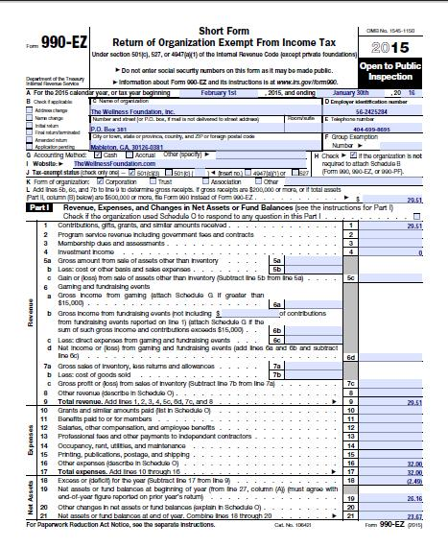
Partnering with the City Council Offices: CPPS Funding
CPPS Application
Additional Forms
Certification for a Drug Free Workplace
The City requires that all City grantees comply with the Drug-Free Workplace Policy (Council Policy 100-17).
EOC Workforce Report
Pages 1-3 must be completed in full.
IRS Form 990
Form 990-EZ, Form 990-PF, and Form 990-N (e-Postcard) accepted.
IRS Form W-9
Notes:
Malachi Bielecki:
The Certification for a Drug Free Workplace is a simple form that the City requires for entering contracts. The EOC Workforce report collects gender and ethnic information on a workplace, and applicants must fill out pages 1-3 as completely as possible. For this form, it is acceptable to put “0” or “N/A,” for not applicable, in any categories for which an organization is unable to answer. The IRS Form 990 is the standard form that we use to verify financial solvency, though this may be exempted for new organizations that do not yet have a filing. Public agencies are not required to provide this form. Lastly, the IRS Form W-9 is an easy form that requires some basic information about the applicant. On this form, please give particular attention to the address and tax identification number and be sure to sign and date the form. It is very important that applicants fill in ALL required fields, especially for signatures and dates. Any missing information can cause a delay in the application or the loss of funding eligibility.

Slide 17
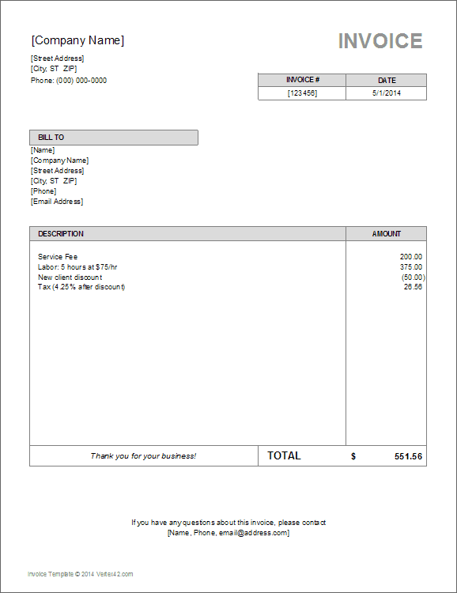
Partnering with the City Council Offices: CPPS Funding
CPPS Payments
Payment Procedure
All funding Agreements must be approved by the full City Council before payments are disbursed.
This process is projected for completion by March 2025.
Once an Agreement is approved, a grantee in good standing will receive the payment outright regardless of whether expenses have yet to be incurred.
Only expenses described in the “Use of City Funds” section of the application as enclosed in the signed funding agreement are permissible uses of awarded funds.
Notes:
Malachi Bielecki:
Our office is required to bring all tentative grant awards before the full City Council for approval, which is a process that takes most of the processing time. Any funding agreement between the City and your organization is not final, and payments cannot be disbursed, until this is complete. For Fiscal Year 2025, we project that this process will be completed by the end of March, though this may be subject to change. Once Council approves an award and all parties have signed the associated funding agreement, a grantee in good standing will be paid their full award amount outright regardless of whether expenses have yet to be incurred. As a reminder, grantees may expense any eligible purchases incurred during the City’s fiscal year 2025. In practical terms, this means that an organization will be effectively reimbursed for any expenses already incurred in the fiscal year and/or granted upfront for expenses not yet incurred. Only expenses mentioned in or closely related to the “Use of City Funds” section of an application as enclosed in the final funding agreement are permissible uses of awarded funds. If an organization documents expenses that do not meet this criteria, the organization must either update their documentation with a compliant use of funds or return the undocumented portion of the award to the City.

Slide 18
Partnering with the City Council Offices: CPPS Funding
CPPS Payments
Payment Procedure
Council Administration will provide a reporting template.
Please retain:
Proof of Purchase documentation (i.e., receipts, invoices, pay stubs, time sheets, etc.).
Proof of Payment documentation (i.e., bank/credit card statement, cancelled check, etc.).
All documentation is due no later than 30 days after the end of Fiscal Year 2025, on July 31, 2025.
Grantees that fail to meet this requirement will be placed on a “Delinquency” list.
Notes:
Malachi Bielecki:
Our team will contact the grantee with instructions when it is time to submit reporting documentation at the end of the fiscal year. Each item expensed to the grant must have two documents corroborating the expense: a proof of purchase document and a proof of payment document. Please be sure to retain these records. Proof of purchase documentation may include receipts, invoices, pay stubs, or time sheets, and proof of payment documentation may include bank statements, credit card statements, or cancelled checks. Lastly, documentation is due no later than 30 days after the end of Fiscal Year 2025, by July 31, 2025. Grantees which fail to meet this requirement will be placed on a “Delinquency list” which will preclude the organization from receiving CPPS or ACCF funding until the delinquency is resolved. To reiterate, the grant award will be disbursed upfront once the funding agreement is executed, and reporting documentation is not due until the end of the fiscal year.

Slide 19
Partnering with the City Council Offices: CPPS Funding
CPPS Payments
Payment Reminders
CPPS funds cannot be disbursed until awards are approved by the full City Council and funding agreements are signed by all parties.
Projected for March 2025.
Funds may be utilized for any eligible expenses incurred within the City’s Fiscal Year 2025 (July 1, 2024 – June 30, 2025).
Full award will be disbursed once the Agreement is approved by the full Council.
Receipt of payment from the City can take up to 30 days once processed.
CPPS applicants should be prepared to finance any proposed projects upfront.
Notes:
Malachi Bielecki:
Here are a few reminders regarding the payment and expense process. CPPS funding is no longer reimbursement only, but funds cannot be disbursed until the award is approved by the full City Council and the funding agreement is signed by all parties. CPPS funding may be utilized for any eligible expense identified in your organization’s funding Agreement that was incurred within the City’s Fiscal Year 2025, which is from July 1, 2024, to June 30, 2025. For example, if your organization requests funding for purchases made in October 2024, the City will not be able to send a payment until the agreement is executed, likely no sooner than March 2025. However, if your organization requests funding for an event in June 2025, then it is possible that CPPS funds could have been disbursed for that project upfront. Either way, your organization will be paid the full award amount as soon the agreement is executed, and all reporting documentation will be due no later than 30 days after the end of the fiscal year. It is important to note that receiving payment from the City can take up 30 days once a payment is approved. As such, we strongly recommend that CPPS recipients be prepared to finance any proposed projects upfront since payment can be delayed and these dates are subject to change.

Slide 20
FY25 CPPS and ACCF
Assistance
To Learn More
Council Offices→ https://www.sandiego.gov/citycouncil
CPPS Homepage → https://www.sandiego.gov/citycouncil/cpps
ACCF Homepage→ https://www.sandiego.gov/citycouncil/ACCF
Office Hours→ By Appointment (Zoom or Phone)
Contact Us
Submit ACCF questions to ACCF@sandiego.gov
Submit CPPS questions to CPPS@sandiego.gov
Council Administration Malachi Bielecki Abigail Edwards 202 C Street, MS 10A Grants Coordinator Grants Coordinator San Diego, CA 92101 Mbielecki@sandiego.gov EdwardsA@sandiego.gov 619-236-6441
Notes:
Thank you for joining us. Please see additional resources on this slide and contact our office if you have any questions.

