Slide 1
The Climate Action Plan and Equity
Roberto Carlos Torres, Social Equity Specialist
Sustainable Energy Advisory Board Meeting
Thursday, September 12, 2019

Slide 2
Equity In the CAP
Address Environmental Justice
Prioritize Communities of Concern

Slide 3
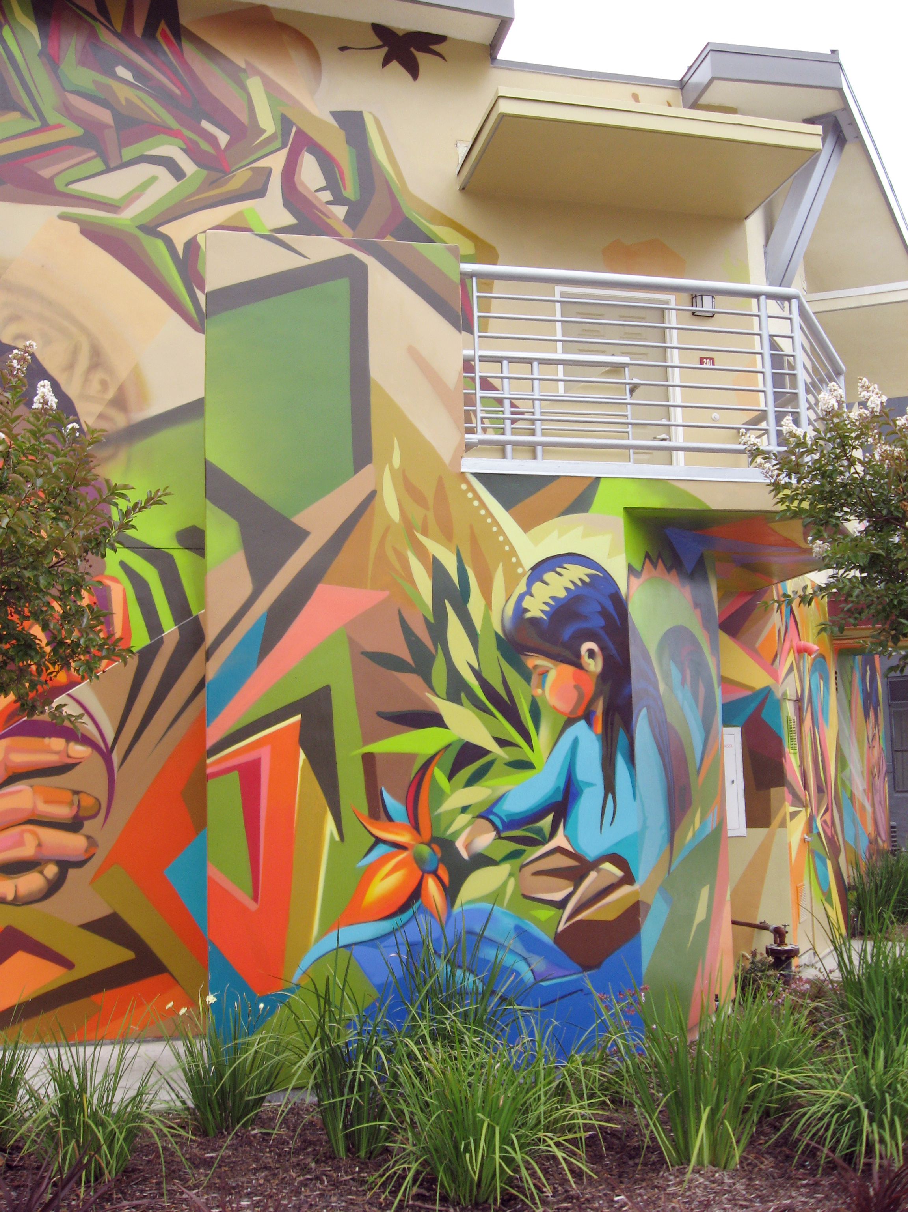
Communities of Concern
Defined as
Council Policy 800-14
Top 30% in CalEnviroScreen
CDBG Eligible Communities
Within ½ mile radius of affordable housing

Slide 4
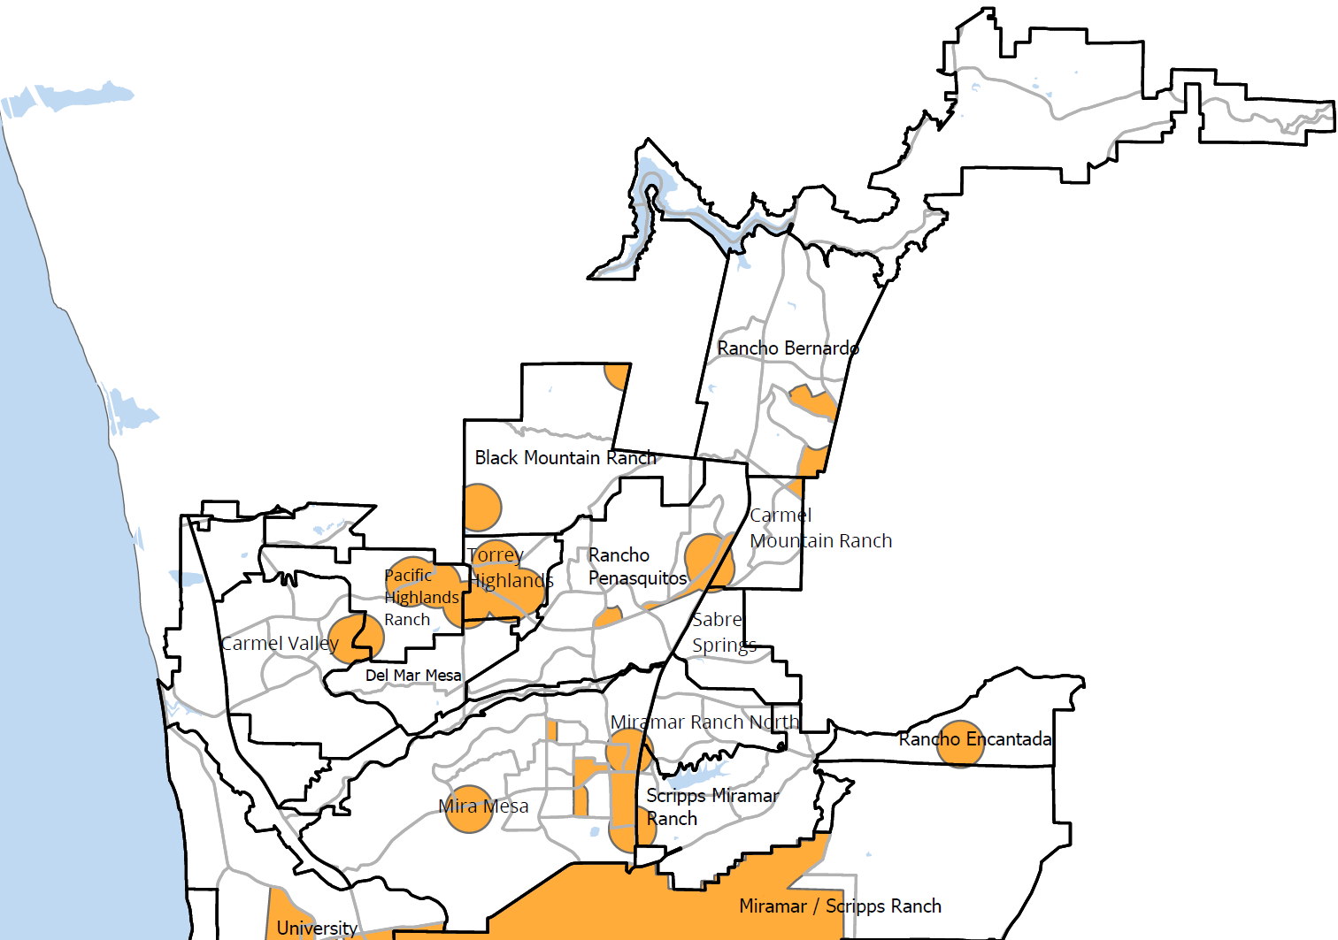
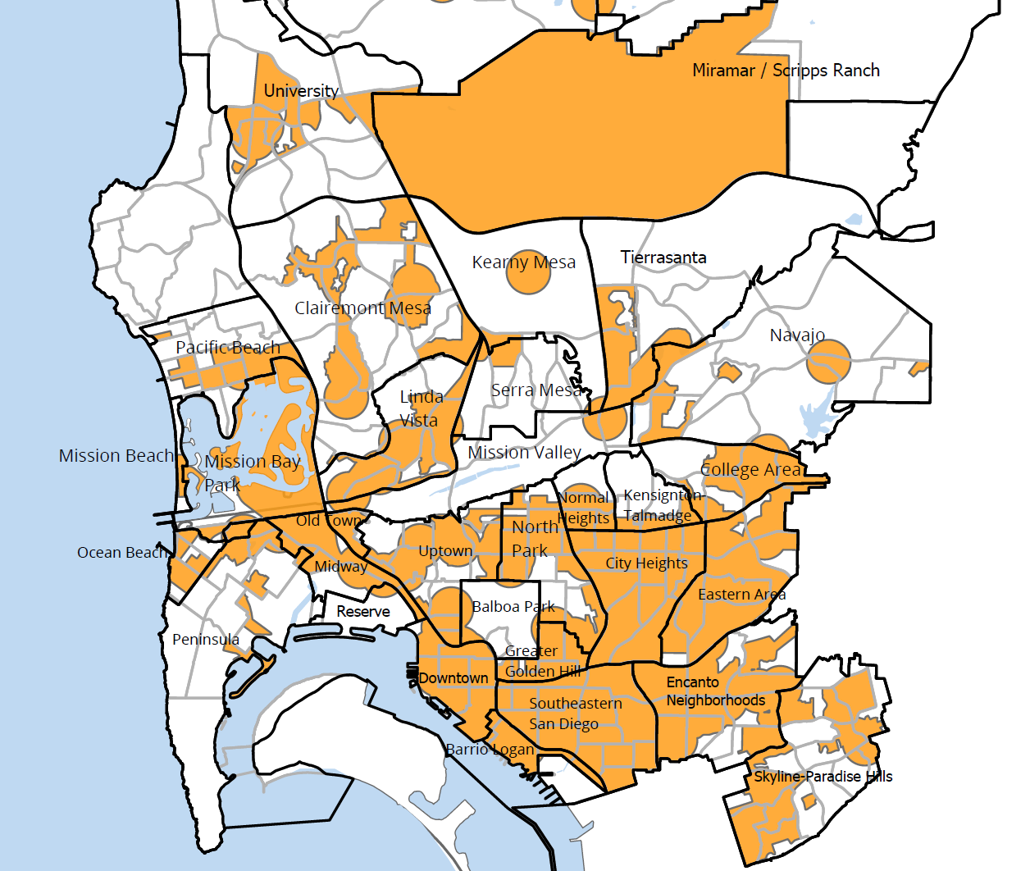
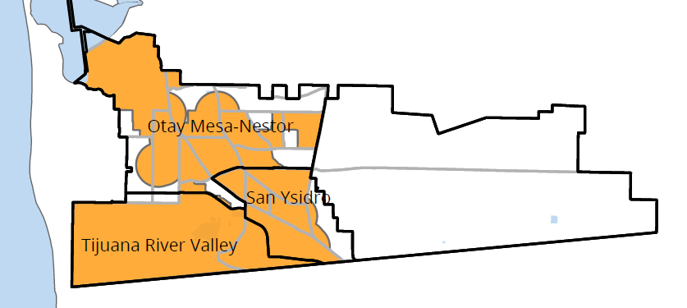
Mapping Communities of Concern

Slide 5
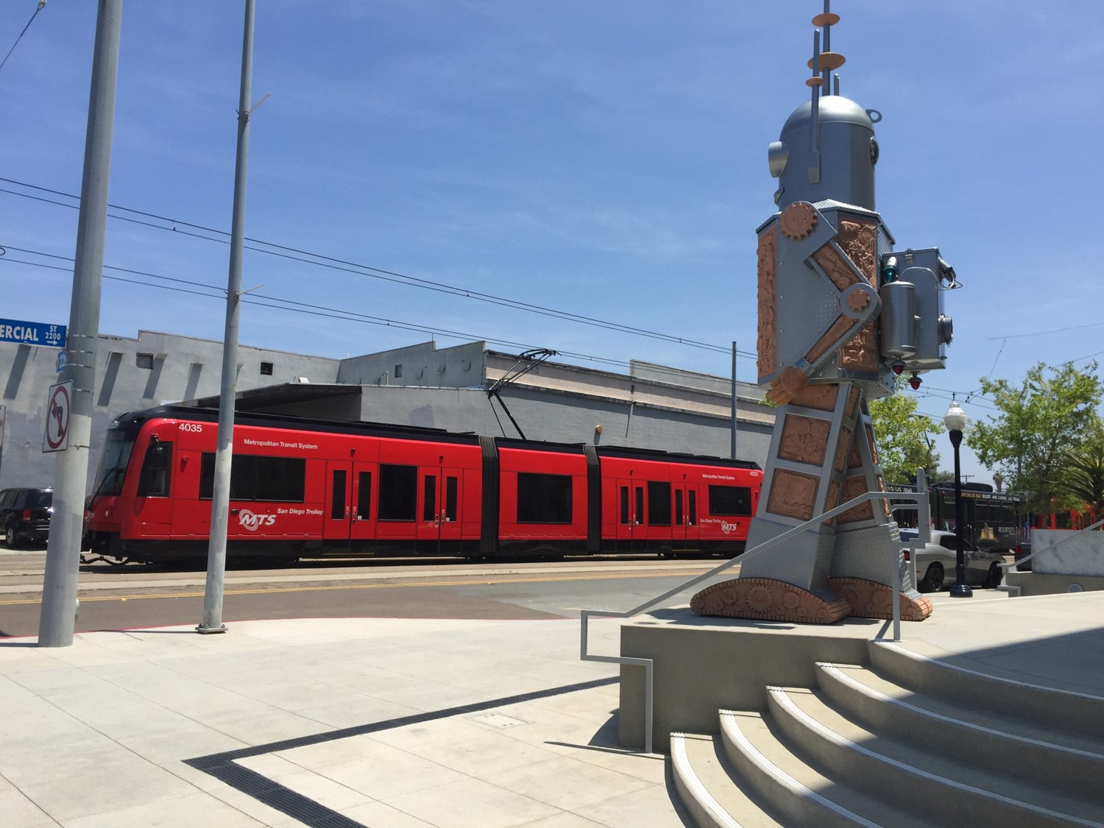
Addressing Climate Equity
Joined Government Alliance for Race and Equity (GARE)
Secured $150,000 Partners for Places Grant
Established informal Equity Stakeholder Working Group
Establishing San Diego’s Climate Equity Index

Slide 6
Thank you!
Roberto C. Torres, Social Equity Specialist
rctorres@sandiego.gov • (619) 533-5974

